Slide 1
Creating and using bookmarks in Power BI

Slide 2
Bookmarks
Bookmarks in power BI are a powerful feature that allows you to capture the current state of a report page and use it for easy navigation, interactivity, and storytelling within your reports. Bookmarks save details like filter settings, the visibility of visuals, sorting order, and drill-down levels, enabling users to create customized and dynamic report experiences.

Slide 3
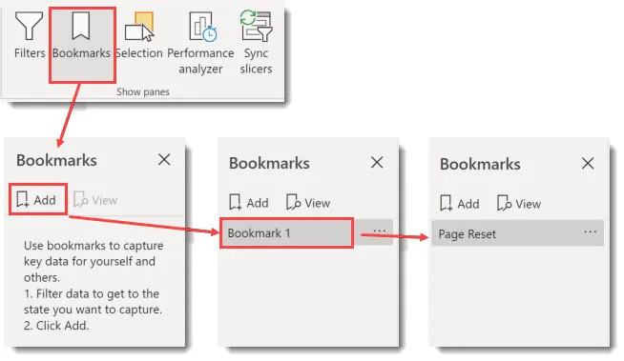
How to create Bookmarks
1. Set up the desired view
Arrange your visuals, set filters, adjust drill-throughs, and format your visuals as you want them to appear in the bookmark.

Slide 4
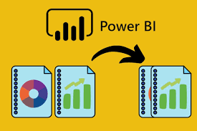
2. Add a bookmark
Go to the “View” tab, select “Bookmarks Pane,” and click “Add.” A new bookmark will appear in the pane, capturing the current state of your report page.
You can rename and arrange bookmarks in any order to keep them organized.

Slide 5

3. Customize bookmark options
Power BI allows you to choose what the bookmark saves
Data: Saves filters, slicers, and drill positions.
Display: Saves visibility and formatting of visuals.
Current Page: Saves the page you are currently on.
You can select which options you want each bookmark to remember, giving you flexibility in how they function.

Slide 6
Using bookmarks
Navigation:
Bookmarks are great for navigation, allowing users to switch between report states or pages effortlessly.
Enhanced Interactivity:
Bookmarks enable interaction without leaving the report page. Use them to create buttons that reveal or hide visuals based on user actions, like showing detailed data when the user clicks a summary chart.
Presenting Data Stories:
Bookmarks are ideal for storytelling, as you can create a series of bookmarks that walk viewers through insights step-by-step.
Bookmark Groups:
You can organize bookmarks into groups, which is helpful for creating toggle effects or managing complex interactions.
Using Buttons with Bookmarks:
Power BI allows you to assign bookmarks to buttons, making it easy to create interactive elements like tabs or custom navigation buttons.

Slide 7
Conclusion
In conclusion, bookmarks in Power BI are a versatile feature that elevates user experience by enabling dynamic navigation, interactive storytelling, and streamlined report customization. By capturing specific views, filters, and visual states, bookmarks make it easy to present data in meaningful ways, create guided narratives, and allow users to explore data insights intuitively. When used strategically, bookmarks enhance report functionality, making Power BI dashboards more interactive, insightful, and user-friendly for a wide range of audiences.

Slide 8


Thank you
ajaycraju98@gmail.com

